Slide 1
Standardize your ML Workflows with ML Platform SDK Wrapper
ML Platform SDK is a configuration-driven wrapper
Ram Vittal
Tech Lead GenAI/ML Platform
WWSO SageMaker AI, AWS

Slide 2
Agenda
What: The ML Infrastructure Challenge
Why: The Need for Simplification
How: ML Platform SDK Architecture
Configuration & Examples
Getting Started
Demo

Slide 3
What: The ML Infrastructure Challenge
Data scientists face infrastructure overhead:
Complex Configuration
VPC, security groups, IAM roles
S3 policies, KMS encryption
Repetitive Code
50+ lines per training job
Copy-paste errors
Governance Gaps
Hard to enforce policies
Limited audit trails

Slide 4
What: Current State Without SDK
Traditional SageMaker requires extensive setup:
Training Job Example
Import 10+ classes
Configure Compute, Networking, Output
Set VPC, subnets, security groups
Specify IAM roles and KMS keys
Result: 50+ lines of boilerplate
Problem: Repeated across projects
Impact: Slow iteration, high errors

Slide 5
Why: The Need for Simplification
Three critical problems:
1. Infrastructure Complexity
Focus on ML, not infrastructure
2. Consistency
Different teams, different patterns
Configuration drift
3. Governance
Central policy enforcement
Audit trails for compliance
Cost management

Slide 6
Why: Business Impact
Quantifiable benefits:
Development Velocity
90% less boilerplate code
10x faster iterations
Team Productivity
New members productive in minutes
Focus on models, not config
Risk Reduction
Fewer configuration errors
Consistent security policies

Slide 7
How: ML Platform SDK (mlp_sdk)
Configuration-driven SageMaker wrapper
Core Concept
Define infrastructure once in YAML
Simple API for ML operations
Override any setting at runtime
Key Features
Session-based with smart defaults
Built-in governance & audit trails
AES-256-GCM encryption
Zero lock-in to underlying SDK

Slide 8
How: Three-Layer Architecture
Intelligent wrapper design:
Layer 1: MLP_Session
Configuration manager
Session orchestrator
Layer 2: Specialized Wrappers
Training, Processing, Feature Store
Pipeline orchestration
Layer 3: SageMaker SDK v3
Full access to underlying SDK
No functionality locked away

Slide 9
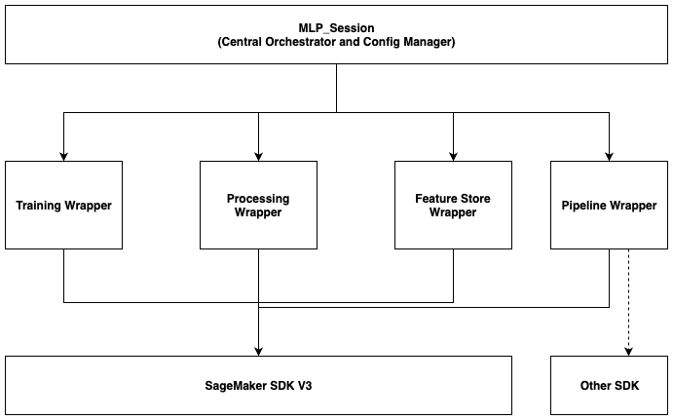
Platform SDK Wrapper Architecture

Slide 10
Configuration Precedence
Three-tier flexibility:
Priority 1: Runtime Parameters
Explicitly passed to methods
Override for special cases
Priority 2: YAML Configuration
Team-wide defaults
Environment-specific settings
Priority 3: SDK Defaults
Built-in SageMaker defaults
Fallback when nothing specified

Slide 11
Configuration File Structure
Define once in admin-config.yaml:
S3: buckets, prefixes
Networking: VPC, subnets, security groups
Compute: instance types, counts
IAM: execution role ARN
KMS: encryption keys (optional)
Generate interactively:
python generate_admin_config.py --interactive

Slide 12
Before vs After: Training Job
❌ Without mlp_sdk
✅ With mlp_sdk
50+ lines of code:
• Import multiple classes
• Define Compute config
• Define Networking config
• Define OutputDataConfig
• Define ResourceConfig
• Create ModelTrainer
• Configure all parameters
Verbose and error-prone
5 lines of code:
trainer = session.run_training_job(
job_name='my-job',
training_image=container,
inputs={'train': 's3://...'}
)
Clean and maintainable

Slide 13
Core Feature: Training Jobs
Simplified training execution:
Basic Usage
session = MLP_Session()
trainer = session.run_training_job(...)
Auto-Configured
✓ Instance type from config
✓ VPC and security setup
✓ IAM role and KMS encryption
Override when needed
Use GPU for specific jobs

Slide 14
Core Features continued..
Processing Jobs
session.run_processing_job()
Simplified data mapping
Feature Store
session.create_feature_group()
Validates definitions
Model Deployment
session.deploy_model()
Auto endpoint configuration

Slide 15
Advanced Capabilities
Audit Trails
Track all operations
Export to JSON or CSV
Encryption
AES-256-GCM for sensitive values
AWS KMS integration
Multi-Environment
Separate configs for dev/staging/prod
Full SDK Access
No lock-in, use low-level APIs anytime

Slide 16
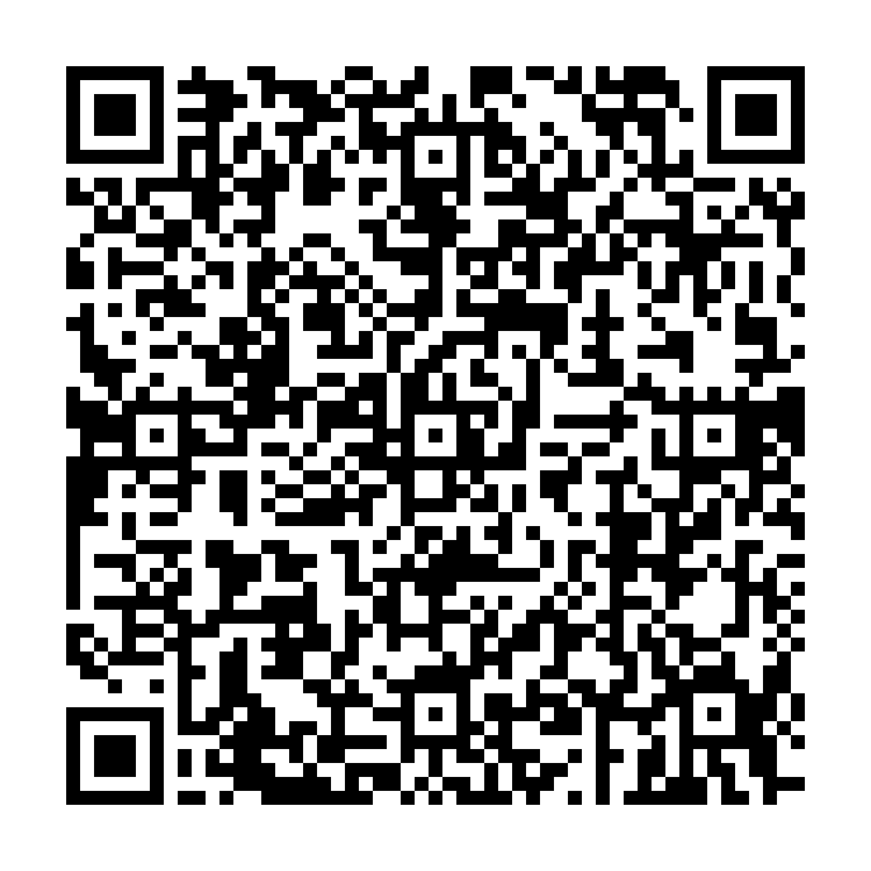
Getting Started (5 Minutes)
Three simple steps:
Step 1: Install
pip install sagemaker-mlp-sdk
Step 2: Generate Config
python generate_admin_config.py --interactive
Step 3: Start Building
from mlp_sdk import MLP_Session
session = MLP_Session()
trainer = session.run_training_job(...)
ML Platform SDK Blog

Slide 17
Demo

